Slide 1


Application Lifecycle and Navigation Design
Lecture-05
Course Code: CSE413
Course Title: Mobile Application Development

Slide 2
Learning Outcomes
Understanding Mobile Application Lifecycle
Designing Intuitive Navigation for Mobile Apps
Implement Navigation Components and Frameworks
Evaluate real-world mobile applications with well-designed navigation structures

Slide 3
The Mobile App Activity Lifecycle: A Deep Dive
1
Understanding States
2
Lifecycle Methods
3
Resource Management
Mobile apps go through different states. These include running, paused, and stopped.
Lifecycle methods manage transitions. These ensure smooth operation.
Proper handling avoids crashes. Effective lifecycle management saves resources.

Slide 4
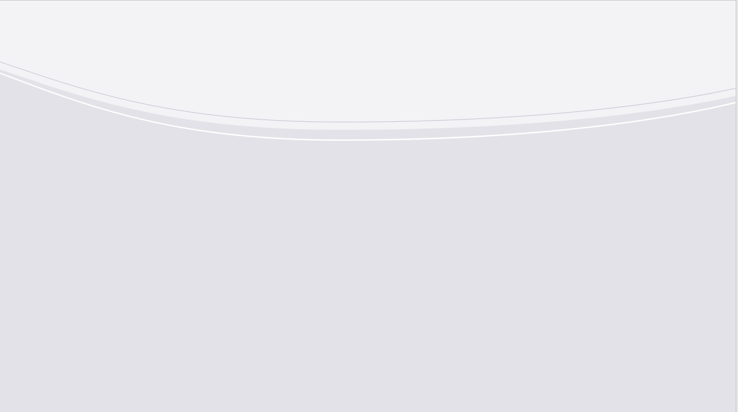

States of Activity: Creation, Pausing, Resuming, and Destruction
1
onCreate()
Initial setup. Load resources.
2
onPause()
App is in background. Save state.
3
onResume()
App returns to foreground. Reload.
4
onDestroy()
Release resources. Clean up.
4

Slide 5
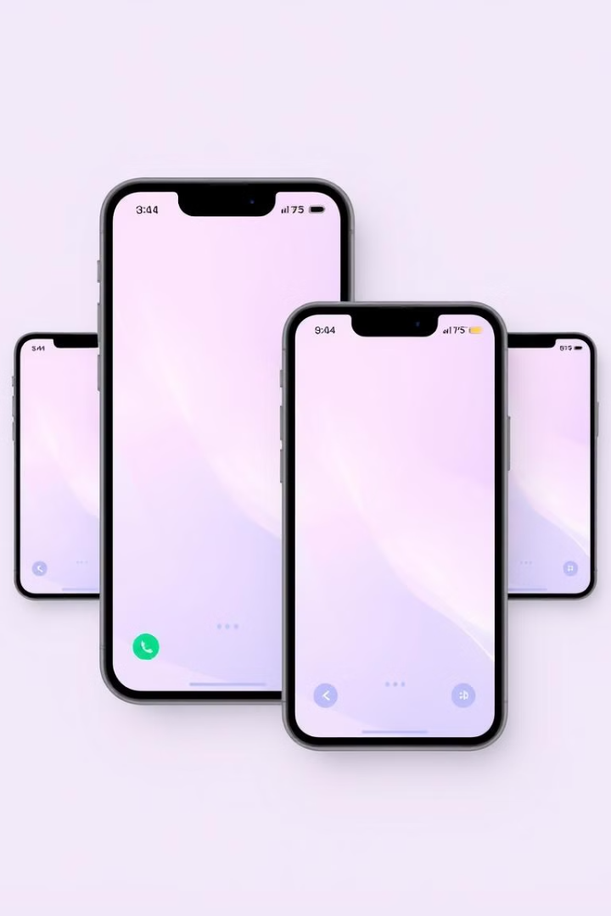
Handling Configuration Changes Gracefully
Orientation Changes
Locale Changes
Avoid restarting. Handle layout changes smoothly.
Support multiple languages. Adapt text and formatting.
Resource Updates
Download new assets. Update UI elements.
5

Slide 6
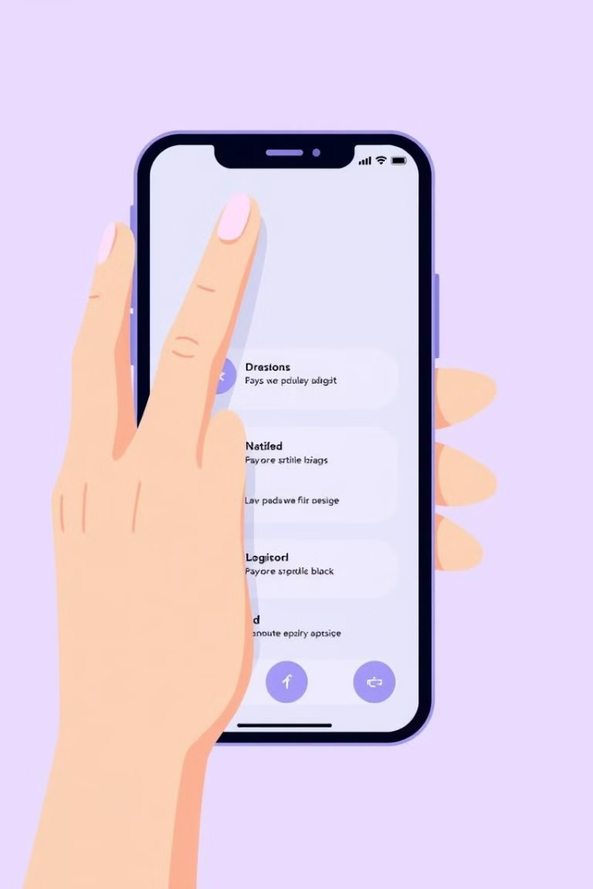



Navigation Design Principles: Keep it Simple!
Clear Goals
Easy Search
Intuitive Flow
Guide users effectively.
Enable quick content discovery.
Create logical paths.
6

Slide 7
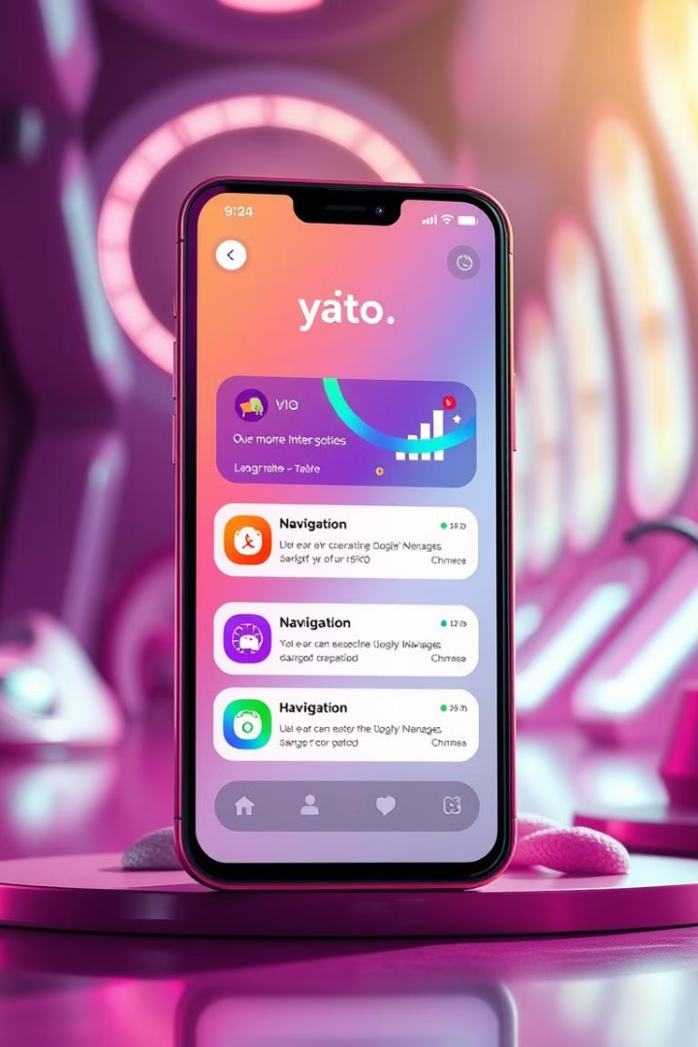



Understanding User Navigation Patterns
User navigation patterns are essential for UX. They help users move through your app.
Common patterns include linear, hierarchical, and webbed. Linear is step-by-step. Hierarchical is top-down. Webbed is free-form. Knowing these patterns is key.
Linear
Hierarchical
Webbed
Step-by-step
Top-down approach
Free-form navigation
7

Slide 8



Flutter Navigation Options
Flutter offers several navigation options. These include Tabs, Drawers, and Bottom Navigation Bars.
Tabs are great for content categories. Drawers are good for settings and profiles. Bottom Navigation is for core features.
Tabs
Drawers
Bottom Navigation
For top-level categories.
For less frequent options.
For primary actions.
8

Slide 9

Implementing Tab Navigation
Use TabBar and TabBarView widgets. Create a TabController to manage tabs. Add tabs to the TabBar widget.
DefaultTabController( length: 3, child: Scaffold( appBar: AppBar( bottom: const TabBar( tabs: [ Tab(icon: Icon(Icons.directions_car)), Tab(icon: Icon(Icons.directions_transit)), Tab(icon: Icon(Icons.directions_bike)), ], ), ), body: const TabBarView( children: [ Icon(Icons.directions_car), Icon(Icons.directions_transit), Icon(Icons.directions_bike), ], ), ), )
9

Slide 10
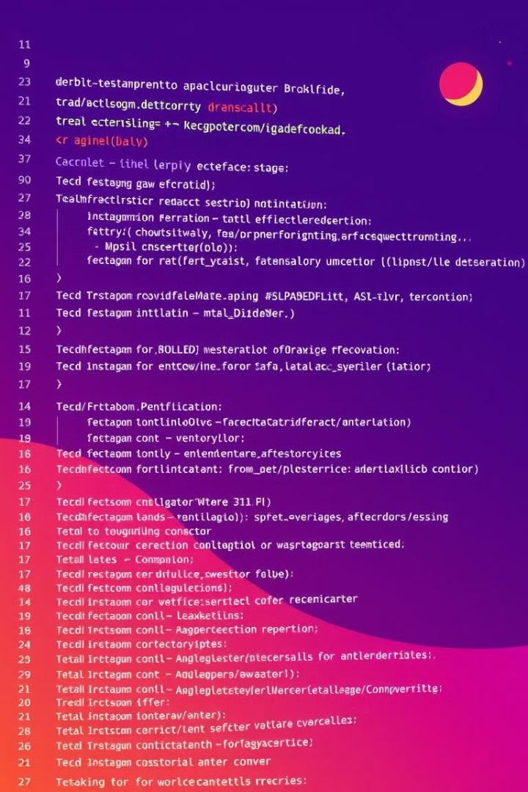
Implementing Drawer Navigation
Use the Drawer widget. Populate it with a ListView. Add ListTile widgets for each navigation item.
Drawer( child: ListView( padding: EdgeInsets.zero, children: [ const DrawerHeader( decoration: BoxDecoration( color: Colors.blue, ), child: Text('Drawer Header'), ), ListTile( leading: const Icon(Icons.home), title: const Text('Home'), onTap: () { Navigator.pop(context); }, ), ], ), )
10

Slide 11
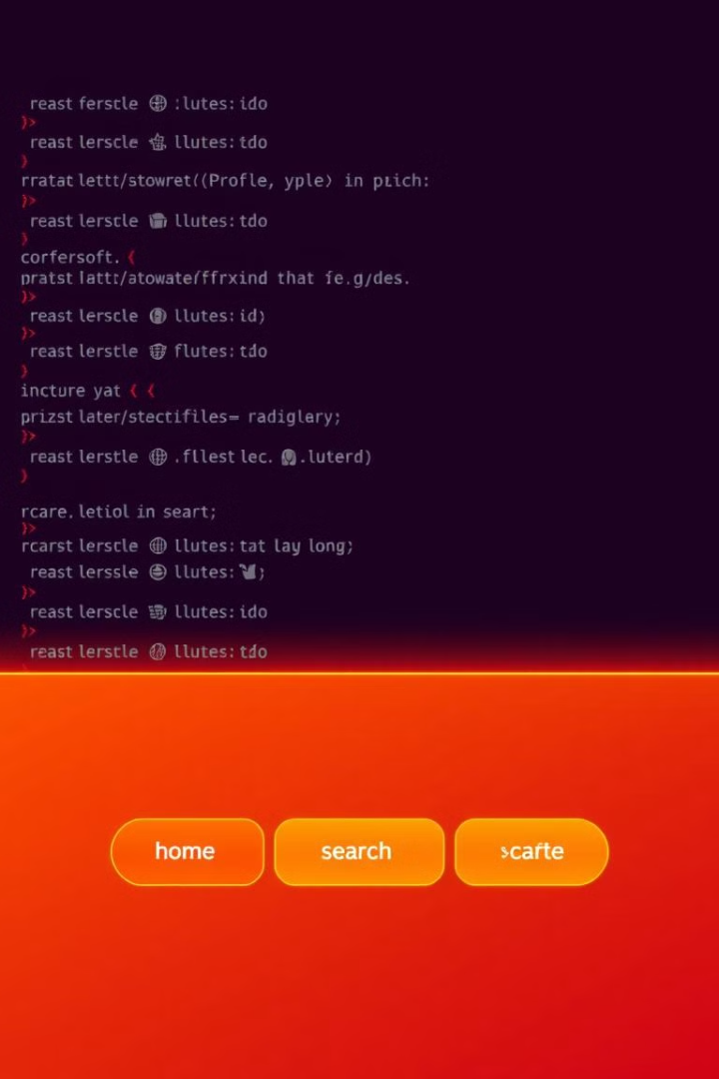
Implementing Bottom Navigation
Use the BottomNavigationBar widget. Define a list of BottomNavigationBarItem widgets. Handle item selection with onTap.
BottomNavigationBar( items: const [ BottomNavigationBarItem( icon: Icon(Icons.home), label: 'Home', ), BottomNavigationBarItem( icon: Icon(Icons.business), label: 'Business', ), BottomNavigationBarItem( icon: Icon(Icons.school), label: 'School', ), ], currentIndex: _selectedIndex, selectedItemColor: Colors.amber[800], onTap: _onItemTapped, )
11

Slide 12
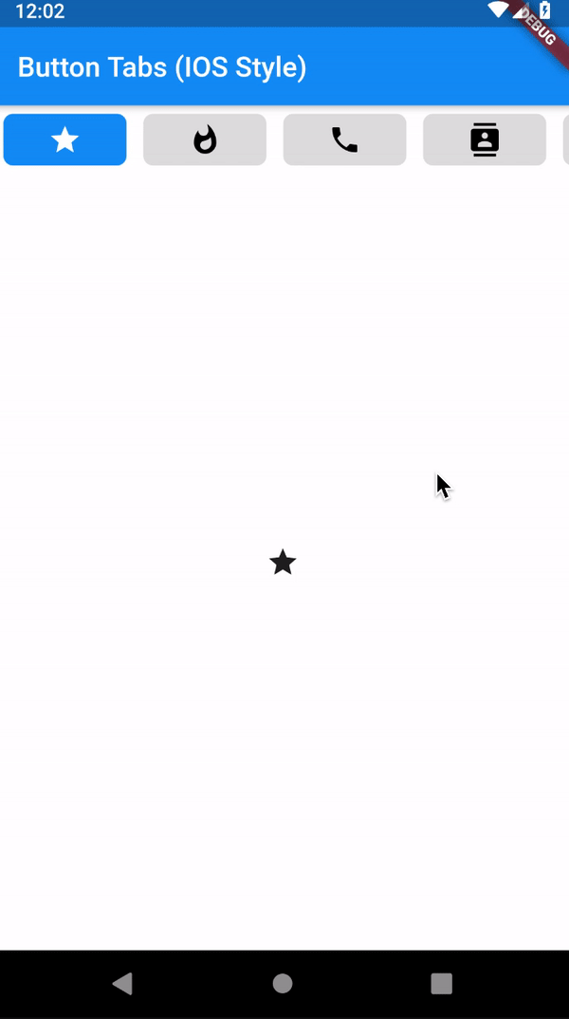
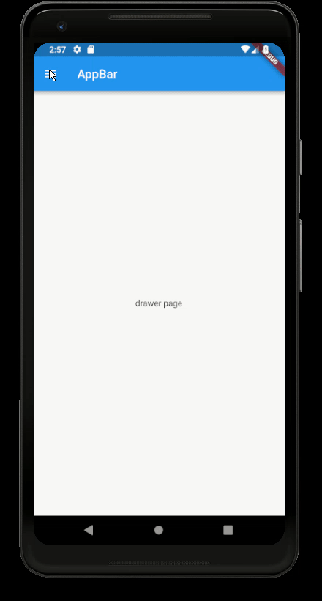
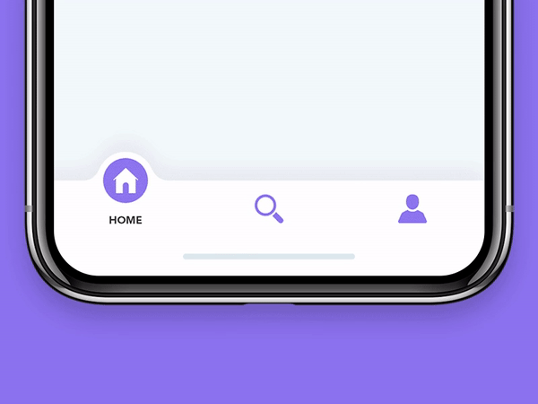
Tab
Drawer
Bottom navigation

Slide 13
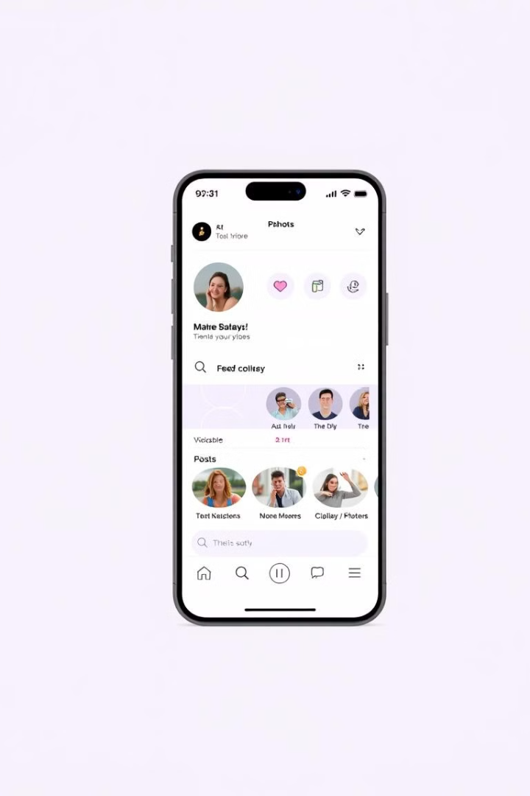
Case Study 1: Navigation Excellence in a Flutter App
1
Clear Structure
2
Effective Search
The app utilizes clear top-level categories that users can easily navigate between.
Users can quickly locate the content they need through efficient search.
3
Logical Paths
The navigation follows a logical path, making it intuitive for users to explore.
13

Slide 14



Case Study 2: Learning from Navigation Pitfalls
1
Obscure Icons
2
Nested Menus
3
Missing Paths
Navigation pitfalls include the use of obscure icons, nested menus, and broken paths.
14

Slide 15
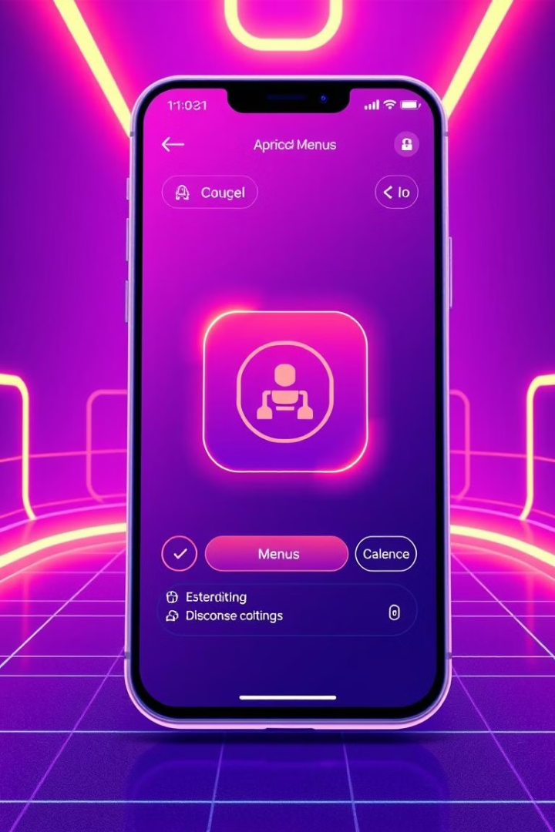
Best Practices
Keep navigation simple and consistent. Use clear labels and icons. Ensure sufficient contrast for accessibility.
Test your navigation on various devices. Get user feedback and iterate on your design.
1
Simplicity
2
Consistency
Keep it simple.
Stay consistent.
3
Accessibility
Ensure it's accessible.
15

